Slide 2
3D blade model updating by coupling HAWC2 and ABAQUS
Maria Luz Castilla Mena (s212601@dtu.dk)
Notes:
Hi, I am Maria and I am going to present my master thesis topic: Evolution of blade cracks with wind turbine simulation tolos (this is a provisional titile, it needs to be discussed)

Slide 3
INDEX
From last meeting
Progress of the project
For the next meeting

Slide 4
From last meeting
HAWC2 doubts
ABAQUS:
Unloading step
Solve amplitude issues
Outline of the Master Thesis for paper

Slide 5
Progress of the project

Slide 6


Progress of the project
HAWC2 doubts
ABAQUS:
Unloading step
Solve amplitude issues
Outline of the Master Thesis for paper
Improved MATLAB interface: workflow completed

Slide 7
Results

Slide 8
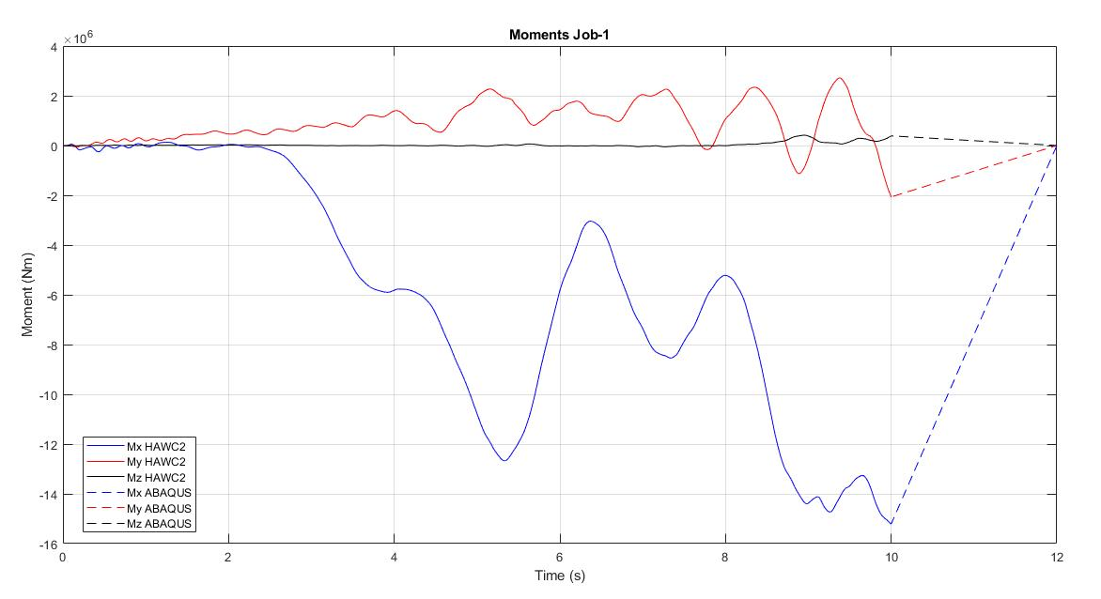
ABAQUS: unloading time = 2 sec

Slide 9
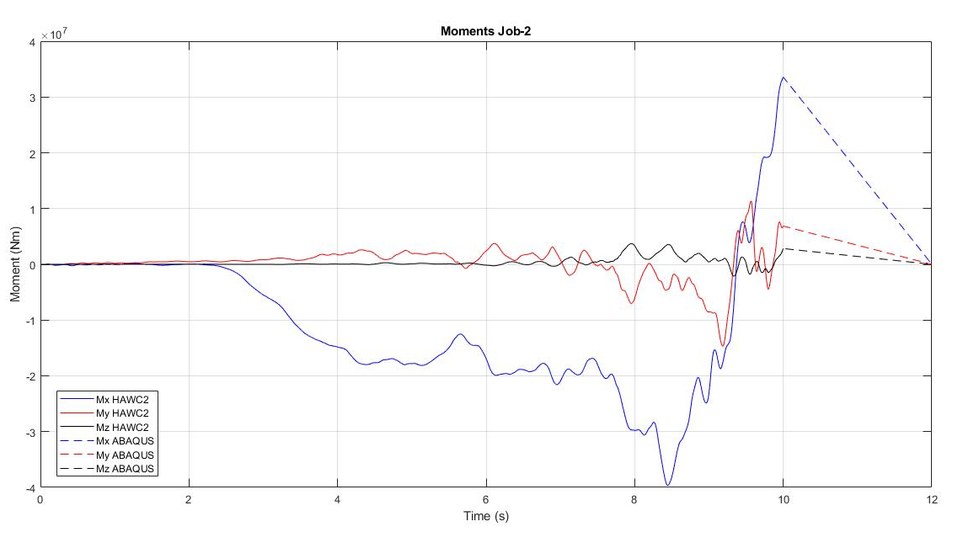
ABAQUS: unloading time = 2 sec

Slide 10
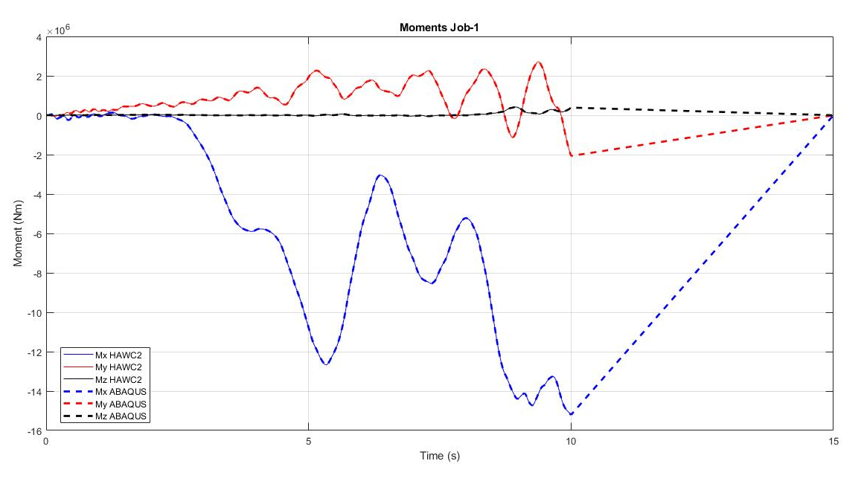
ABAQUS: unloading time = 5 sec

Slide 11
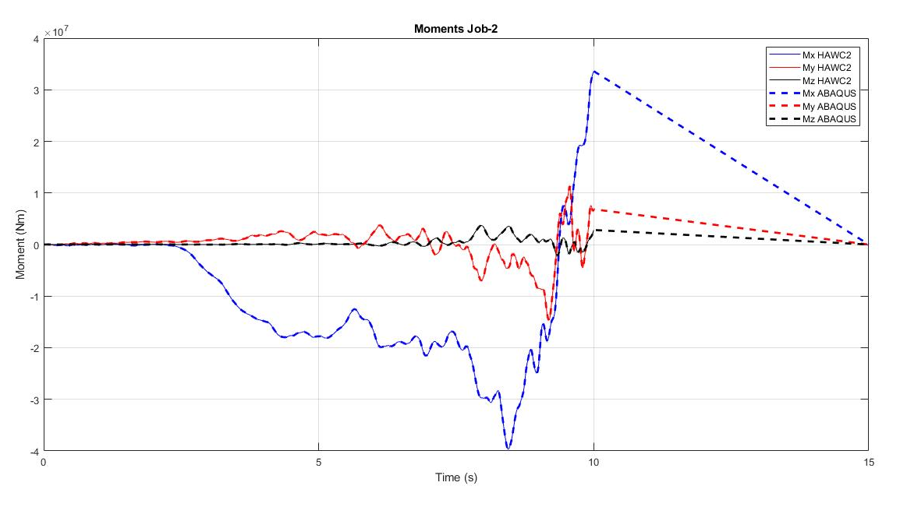
ABAQUS: unloading time = 5 sec

Slide 12
Outline paper
(Significance)
Introduction: The upcoming of a storm and the importance to react accordingly
1.1. Storms: Why they should be analyzed in a wind turbine context
1.2. General procedure of wind turbines during a storm
MATLAB interface to predict wind turbine blade behaviour during a storm
2.1. Introduction: Virtual simulation using HAWC2 and ABAQUS
2.2. Why linking these programs
2.3. Workflow of the simulation
Simulation: Real example of a storm wind profile
Results and analysis of the simulation using the MATLAB interface
Conclusión: why using this interface
(Objective)
(Added value to
research community)

Slide 13
Outline paper
Modified version after the meeting
Introduction: The upcoming of a storm and the importance to react accordingly
1.1. Storms: Why they should be analyzed in a wind turbine context
1.2. General procedure of wind turbines during a storm
1.3. Objective and significance
1.4. Introduction: Simulation using HAWC2 and ABAQUS. Why linking these programs?
MATLAB interface to predict wind turbine blade behaviour during a storm
2.1. Workflow of the simulation
Case study: Real example of a storm simulation and results using the MATLAB interface
Conclusion: added value to the research community.

Slide 14
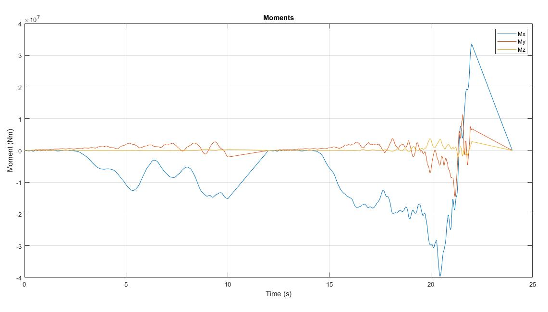
MATLAB workflow

Slide 15
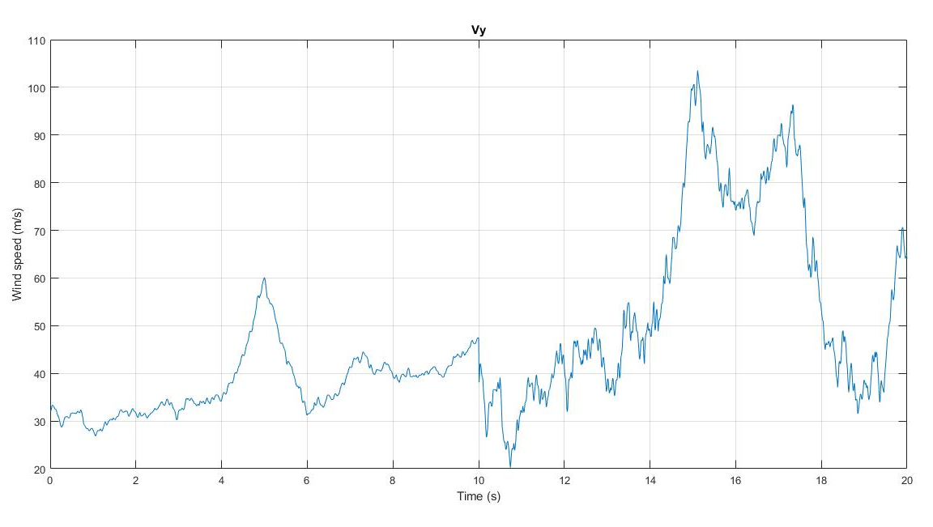
MATLAB workflow

Slide 16
For next meeting…

Slide 17
For the next meeting
HAWC2 doubts?
How to model HAWC2 in MATLAB
Update structural results in HAWC2?
Suggestions?

